Slide 1
Single lane

Slide 2
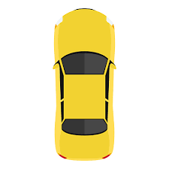

Slide 3
Double lane (passing)

Slide 4
C
d
B
A
C
d
A
B

Slide 5
Double lane (fast)

Slide 7
Intersection

Slide 8
* Not drawn to scale
F
C
WN
D
WS
3m
B
E
100 m
A

Slide 9

* Not drawn to scale
WN
East ped
Q3
Q2
WS
Q0
Q1
West ped

Slide 10
* Not drawn to scale
WN
East ped
WS
West ped
speed_0 = 87.1 m
car.require

